Slide 1


V1TA
Train a V1T-like architecture to predict neural activations
using Allen Brain Observatory Dataset
TEAM: Fernando Riccioli, Nunzio Fornitto, Angelo Frasca
1000069299, 1000002901, 1000067615
Cognitive Computing and Artificial Intelligence Course - University of Catania, Italy

Slide 2

OUTLINE
Introduction
Understanding the Dataset
Adapting Allen to V1T
V1T Architecture
Training
Conclusions

Slide 3
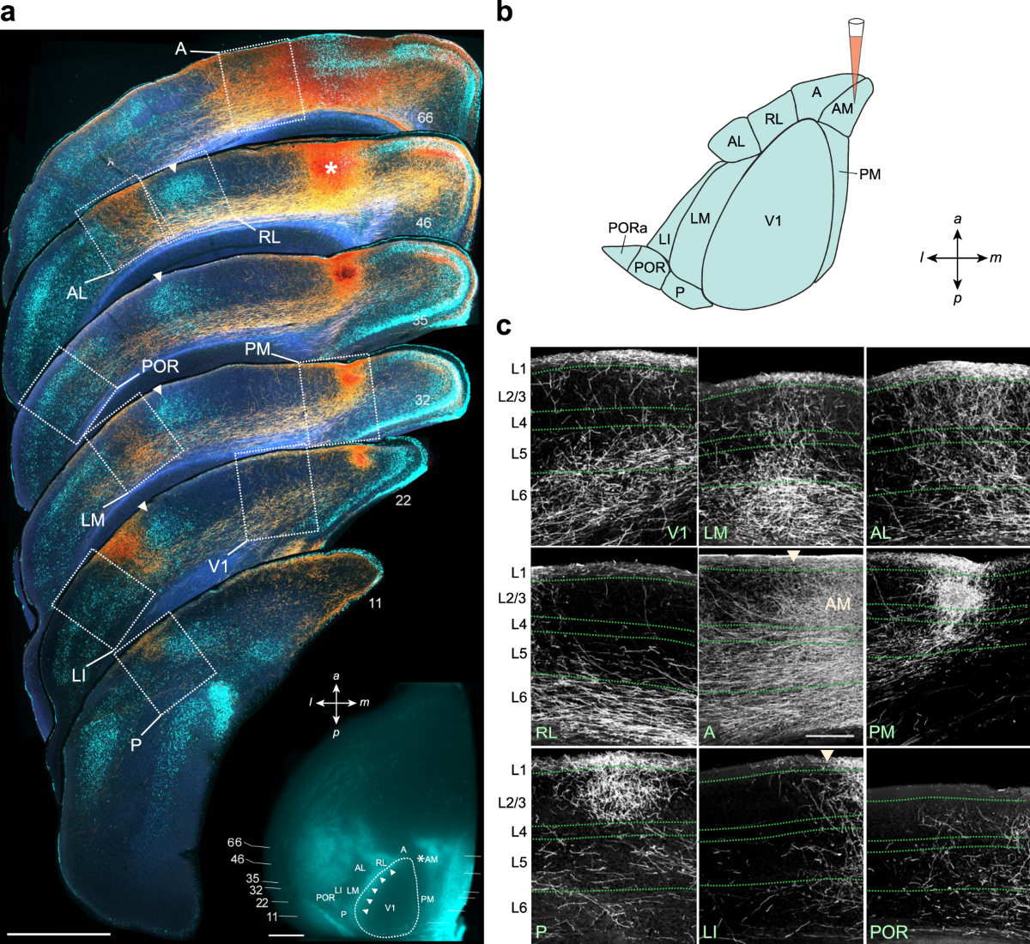
V1T Explained
A Vision Transformer architecture that predicts neural activation in mice.
The name comes from the area of the brain called Primary Visual Cortex (V1)
This is the area which is subject to our study.

Slide 4
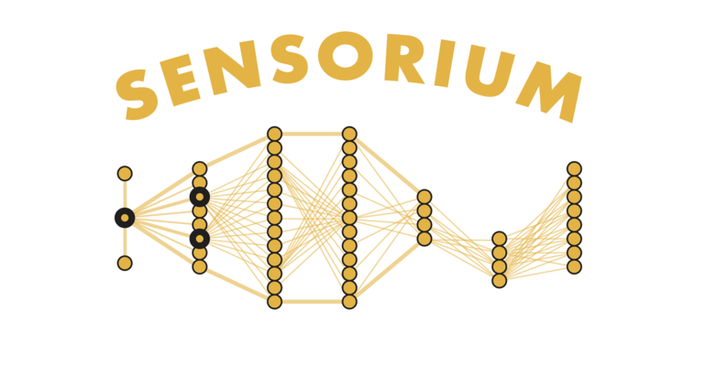

Goal of the Project
V1T is designed to work with Sensorium Dataset or Franke 22 Dataset
Our goal is to adapt the Allen Brain Observatory Dataset to make it work with V1T, understand it and train the model.

Slide 5
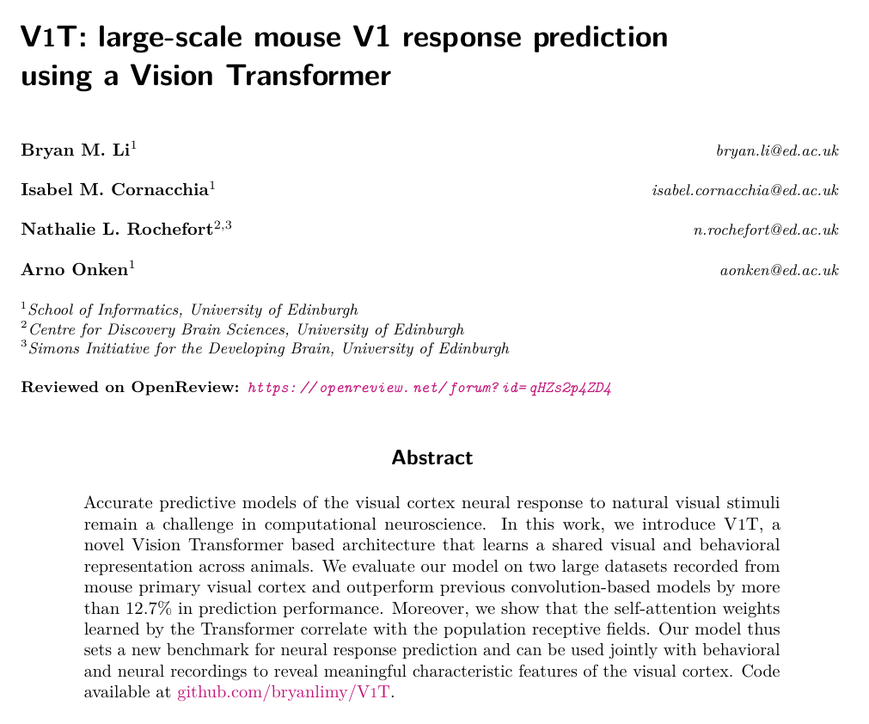
Tools and Resources
V1T source code: bryanlimy/V1T: Code for "V1T: Large-scale mouse V1 response prediction using a Vision Transformer"
V1T paper: V1T: large-scale mouse V1 response prediction using a Vision Transformer | OpenReview
Google Colab Pro: https://colab.research.google.com/
Allen Dataset Explanation & Examples:
AllenInstitute/brain_observatory_examples | Github
Original V1T Paper (Bryan M. Li)

Slide 6
UNDERSTANDING THE DATASET
Allen Brain Observatory

Slide 7
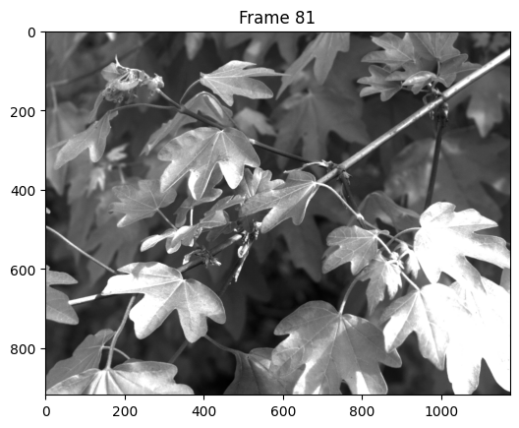
What happens during a Session
A mouse is shown a sequence of images or videos. These can either be natural or artificial (called gratings).
Each image is presented for 250 ms before switching to another.
In the session each image is presented 50 times at random intervals.
All images and videos are in grayscale.
Frame 81 from Natural Scene Table

Slide 8
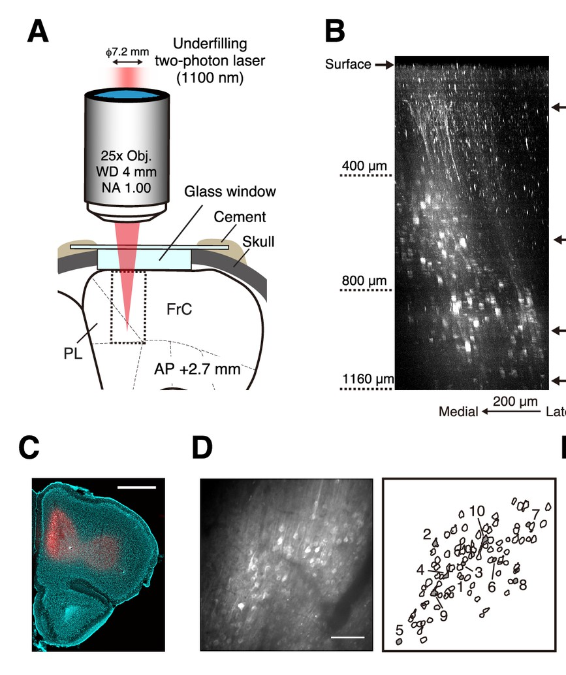
Neural Activation & Behavior
Neural activation is measured by calcium imaging: calcium protein enters the neuron when it's active and makes it fluorescent.
A microscope (2 photon) measures the variation of fluorescence. This measure is called ΔF/F.
But neural activation depends on the current state of the brain as well.
This is why to have better performance during training we need behavioral information such as running speed or pupil dilation.

Slide 9
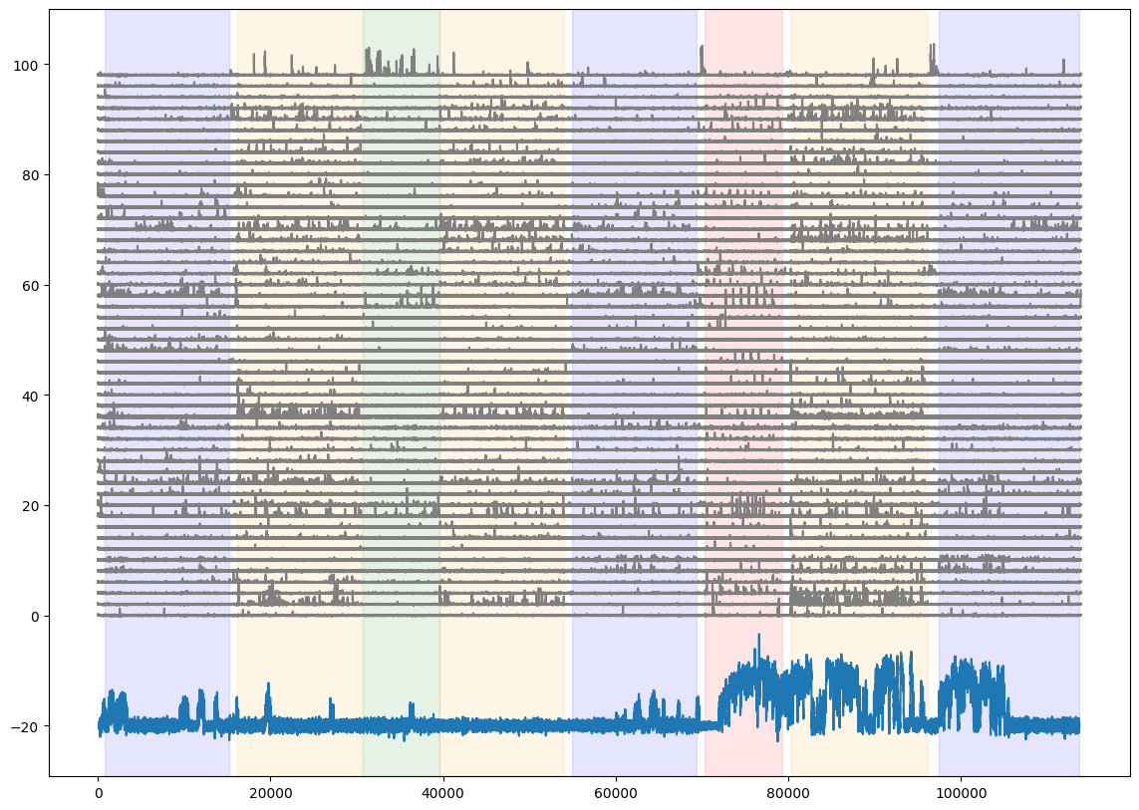
Data Plot
This is a partial plot of the data
X-Axis: frames
Y-Axis: ΔF/F and running speed (cm/s)
Total Neurons: 174
Total Frames: 11388
Duration in minutes: 63.3

Slide 10
Data Plot
X-Axis: frames
Y-Axis: ΔF/F and running speed (cm/s)
Different colours are different "stimulus epochs".
Yellow are natural images and blue are static gratings.

Slide 11
ADAPTING ALLEN TO V1T
Data & Metadata Processing

Slide 12
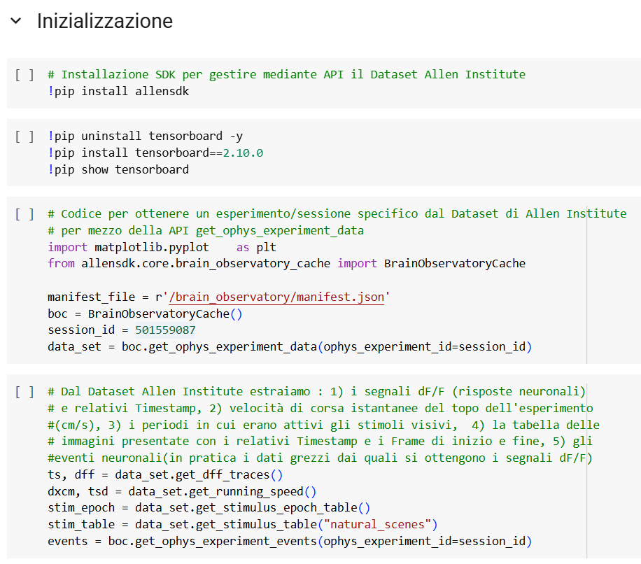
AllenSDK
Allen Brain Observatory dataset is available using AllenSDK
!pip install allensdk
Within the code itself we can choose which sessions to use
session_id = 501559087
And get the data we need (ΔF/F, running speed, images)
ts, dff = data_set.get_dff_traces()
dxcm, tsd = data_set.get_running_speed()
stim_table = data_set.get_stimulus_table("natural_scenes")
From notebook.ipynb

Slide 13
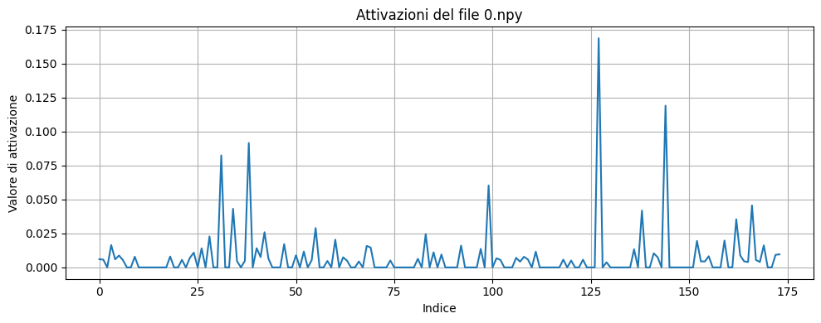
Processing Stimuli
Neural activations are saved as a single value taken every ~33ms.
To use them in V1T we average over 500ms, similar to how it's done in V1T original dataset.
The results are saved in .npy files, each of which contains 174 values. One for each neuron

Slide 14
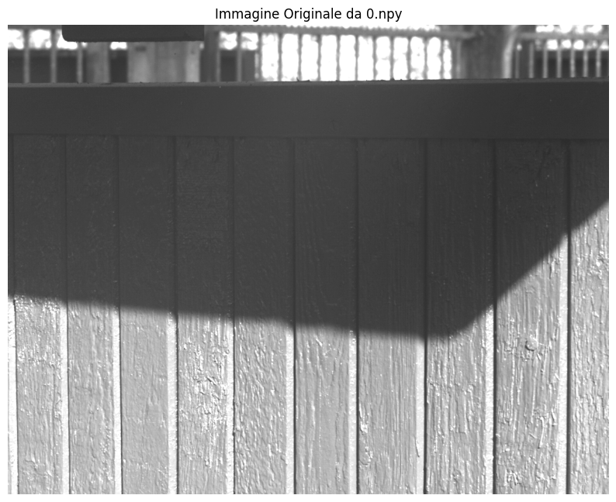
Extracting Stimulus Images
We chose to use only natural scenes.
These are found in "natural_scene_template"
After they are loaded, they are processed and saved in .npy format.
The number of unique images is 118, each with a resolution of 918×1174.
The total number of .npy files for the images is 5950 (one for each trial).

Slide 15
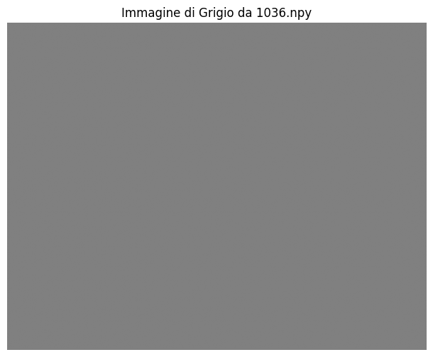
Grey Images
During the experiment the mouse was shown a grey screen between some images.
These are not available in the dataset, so as a bonus we created them from scratch.
These are a total of 50 images shown a different times during the experiment.
These are created using a grey value of grey_value = 128

Slide 16

Image Resizing for V1T
The original images from the Allen dataset are 918×1174 pixels.
Since the V1T model expects input of size 144×256 we resize all images.

Slide 17
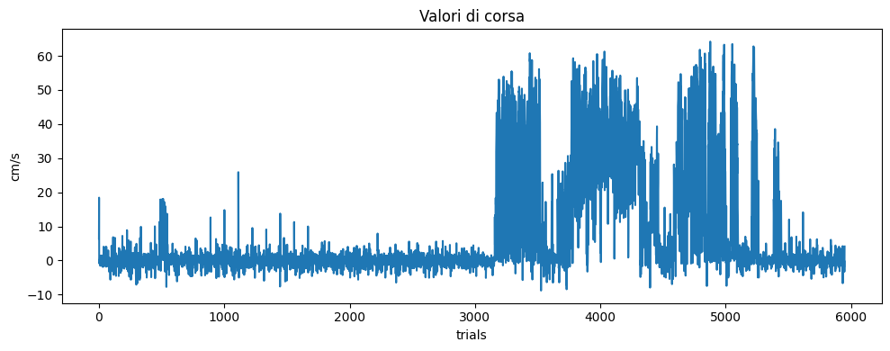
Running speed
For each trial we have a corresponding running speed (in cm/s)

Slide 18
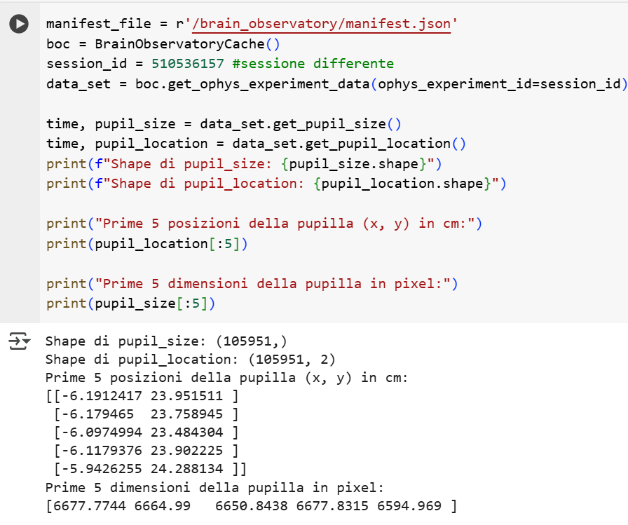
Pupil Size
Pupil size is not available for our current experiment session.
However we left the methods to get pupil size size for other Allen Institute experiments as integral part of our code.
This makes it possible to add pupil size in a V1T project with a different experiment session.
Code Snippet to Load Pupil Size

Slide 19
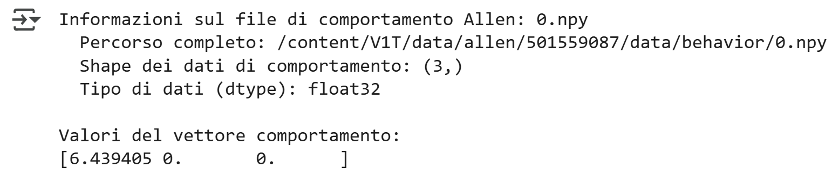
Behavior
Since pupil size and pupil derivative are unavailable we create an array with running speed as the first value and 0. as second and third value.

Slide 20
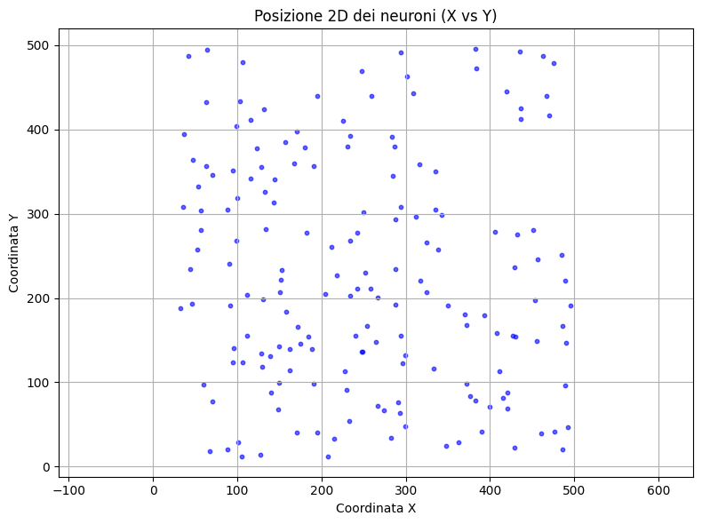
Neuron Metadata
The first file we need is "unit_ids.npy" containing a numerical ID for each neuron.
[1, 2, 3, ... 173, 174]
The second is "cell_motor_coordinates.npy" which contain the 3D coordinates for each neuron.
[292.91147 63.505207]
[274.3859 66.493774]
…
[492.45386 47.046154]
Depth is the same (175µm) for each one.
This is used to in the Gaussian Readout module to enhance training performance.

Slide 21
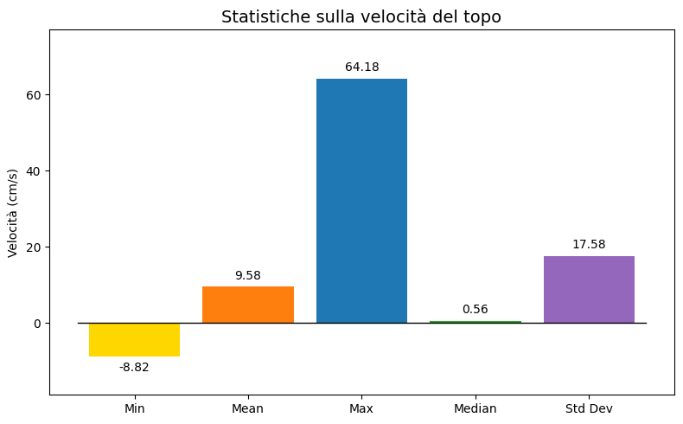
Statistics
For images, behavior and neural responses we need to compute manually
'min.npy', 'max.npy', 'mean.npy', 'median.npy', 'std.npy'
These are used by the model for normalization and other processes before training.
For running speed we get:
Min: -8.82, Max: 64.18, Mean: 9.58, Median: 0.56, Std: 17.58

Slide 22
V1T ARCHITECTURE
An In Depth Look

Slide 23
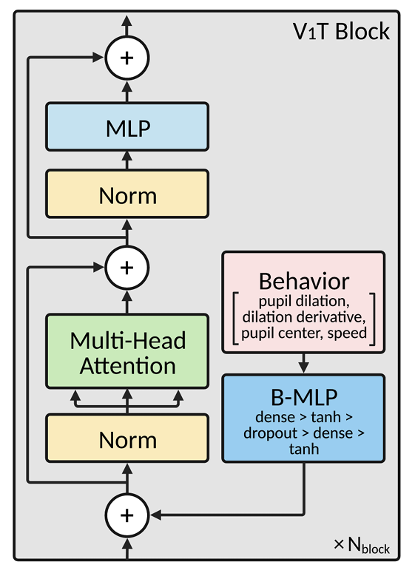
V1T Architecture
Input: images (1 channel, 36×64)
Output: 174 predicted neural responses
Approach: Vision Transformer + Gaussian2D Readout
In this project, the model takes images as input and predicts the response of 174 neurons. It’s based on a Vision Transformer and a readout mechanism called Gaussian2D.

Slide 24
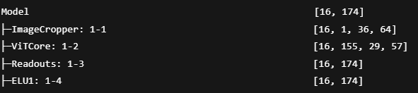
Full Model Structure
This is the complete structure of the model. Now we’ll analyze each block step by step.

Slide 25
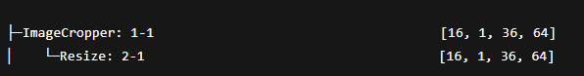
Preprocessing: Image Cropper
Resizes the image to 36×64 Prepares images for the transformer
The first step is an optional resizing. Input images can be resized to 36×64 pixels for efficiency

Slide 26
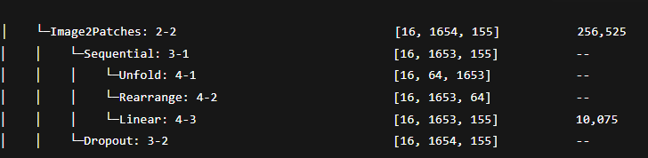
Encoding: Image2 Patches
Splits image into patches Projects each patch into a 155-dimensional embedding
Each image is divided into small patches, and each patch is projected into an embedding vector. This is the first step toward converting an image into a sequence

Slide 27
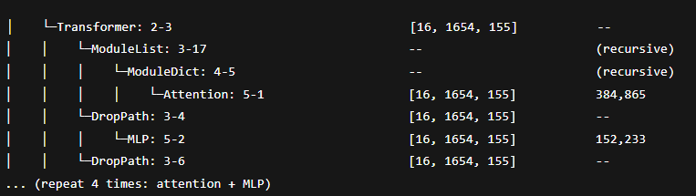
Vision Transformer Core
4 Transformer blocks: Attention + MLP Enables global interactions between patches
The core of the model is the Transformer. Each patch can communicate with all others through self-attention, learning spatial relationships

Slide 28

Rearranging Features
Transforms sequence back to spatial format
Shape: [1654, 155] → [155, 29, 57]
Once the patch embeddings have been processed, we rearrange them into a 2D spatial map, which will be used by the readout layer

Slide 29
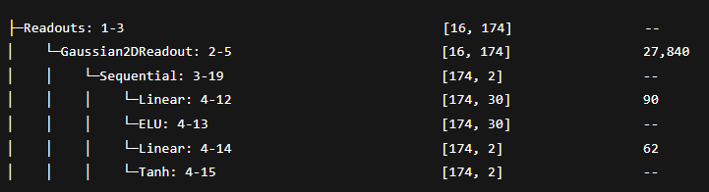
Gaussian2D Readout
Each neuron "looks" at a (x, y) location
Gaussian sampling + neuron-specific MLP
Each neuron is associated with a spatial location on the 2D feature map. Around that location, we apply a Gaussian sampling and use a small MLP to compute the output

Slide 30
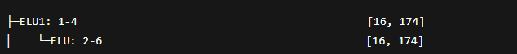
Final Non-Linearity
Applies ELU on final output
Helps mimic biological neuron firing pattern
Finally, the output goes through an ELU activation. This helps the model better approximate the non-linear behavior of real neural responses

Slide 31
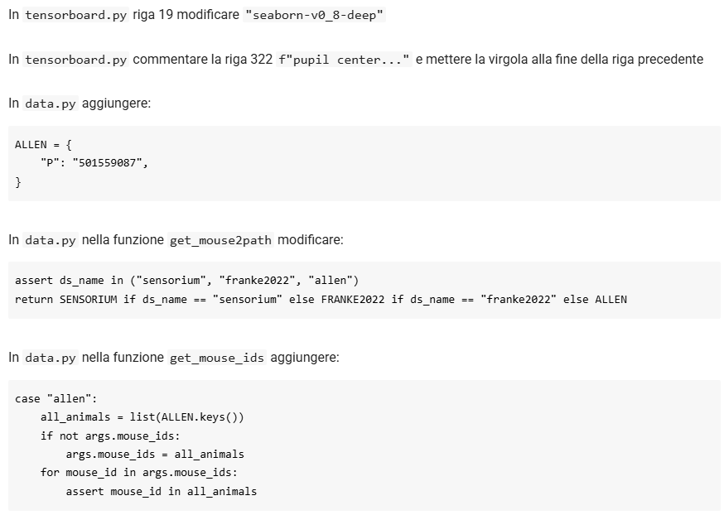
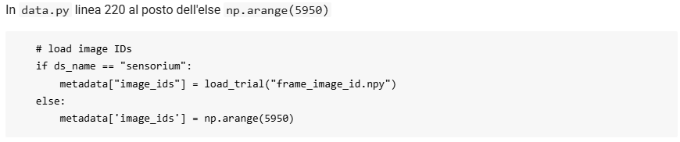
Necessary Changes
To make V1T work with a different dataset we need to change the original code.
As an example we add checks and dictionaries related to our new dataset in data.py.
And we create new .npy files for image data.

Slide 32
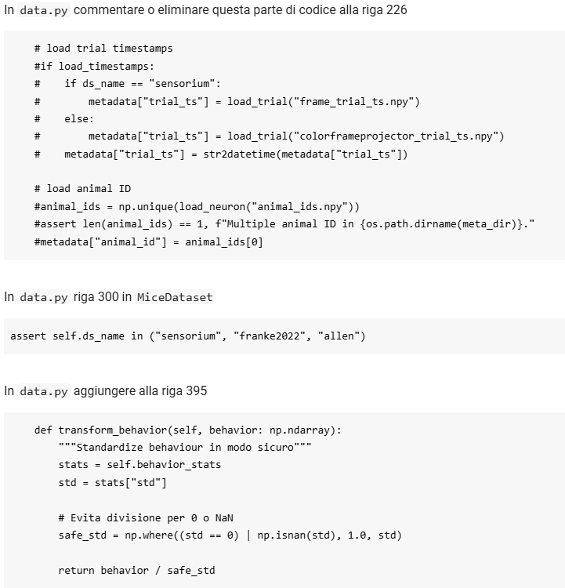
Necessary Changes
Adapting a foreign dataset to V1T has taken a considerable amount of our time.
Before training we did a lot of trial and error to find the file configuration to make V1T start.
As we can see on the left, we study and make changes to different parts of code such as troubling functions and datasets.

Slide 33
INTERACTIONS WITH V1T'S AUTHOR
Thoughts and Recommendations

Slide 34
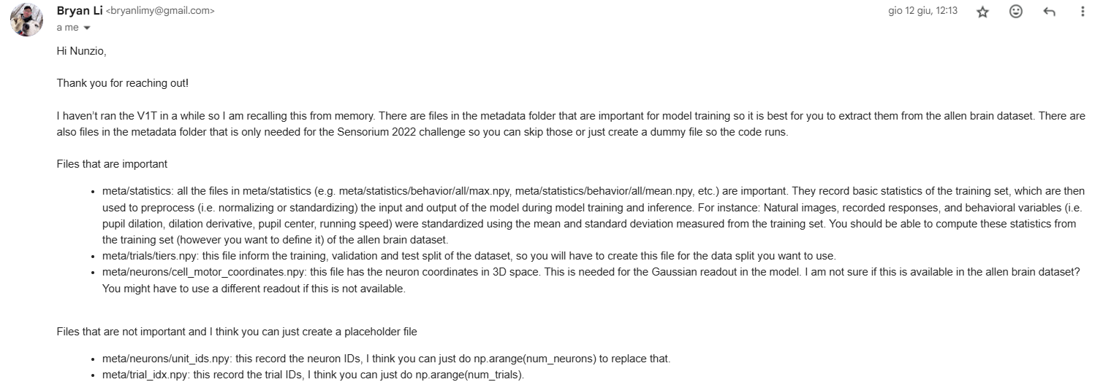
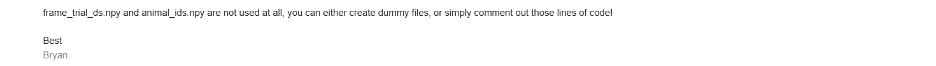
Important Files

Slide 35
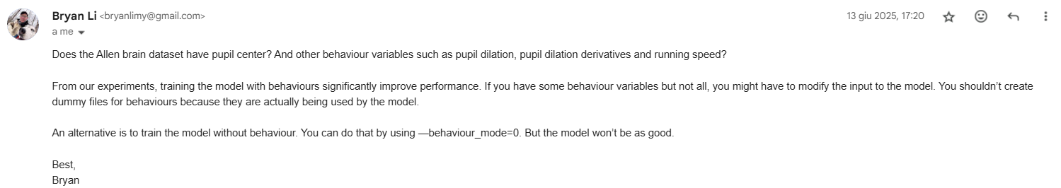
Placeholder and Unavailable Files
Since data as pupil center, pupil dilation and pupil derivatives are not available for our session, we can use --behavior_mode=1 but we measure no significant improvement
According to our research and Bryan's findings this explains our training results.

Slide 36
TRAINING
Highlights

Slide 37
Training Parameters
The model can be run using different configurations, passed through parameters. The parameters that have been set for the various training tests are:
Parameters | Type | Default | Description
--dataset | str | REQUIRED | Path to the data folder
--output_dir | str | REQUIRED | Where to save results/model
--behavior_mode | int | REQUIRED | Behavior Mode (0-4)
--resize_image | int | 1 | If 1, resize to (36×64), if 0, leave (144×256)
--gray_scale | flag | False | If True, converts image to grayscale
--limit_data | int | None | Limit the number of samples

Slide 38
Training Parameters
Other important parameters for training are the following
Parameter | Type | Default | Description
--epochs | int | 400 | Maximum number of training epochs
--batch_size | int | 8 | Global batch size
--criterion | str | poisson | Loss function
--core | str | REQUIRED | ”conv", "vit", "cct", "stn", "stacked2d"
--readout | str | REQUIRED | "gaussian2d"
--shift_mode | int | 0-4

Slide 39
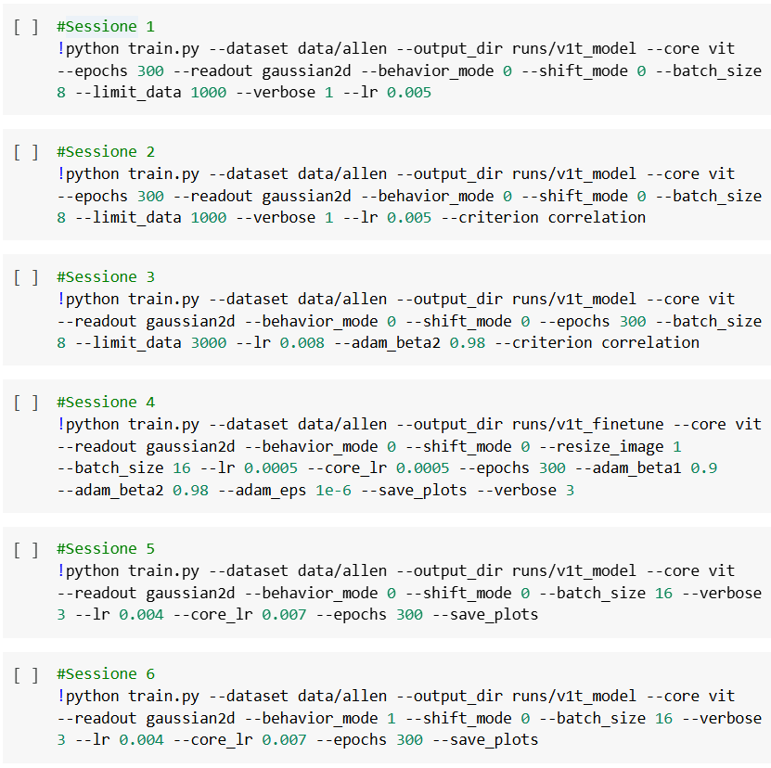
Training sessions
Several training sessions were conducted, each with different training parameters. In the next slides we show a summary of the most significant.
From the first session to the last, performance improves, both because of the increasing number of data samples and more suitable hyperparameters
Training Sessions Summary

Slide 40
Session 1
Limit data is used to train quickly due to timing and computing power restriction.
core_lr takes the default value, since it's not explicitly set. The batch size has been reduced to 8.
!python train.py --dataset data/allen --output_dir runs/v1t_model --core vit --epochs 300 --readout gaussian2d --behavior_mode 0 --shift_mode 0 --batch_size 8 --limit_data 1000 --verbose 1 --lr 0.005

Slide 41
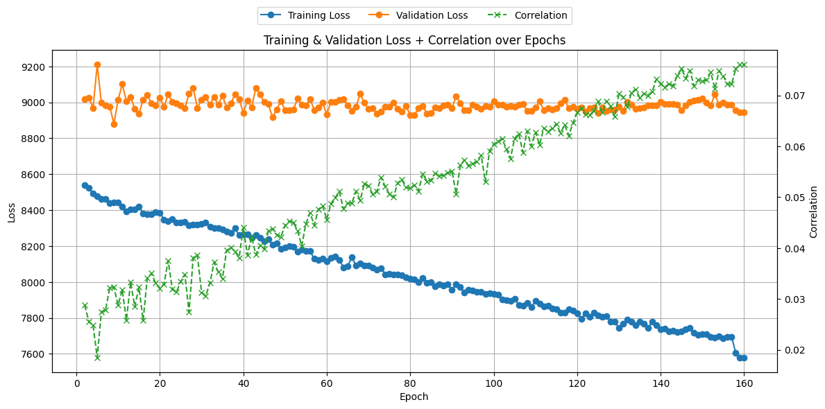
Session 1
Epoch 1
Train loss: 8366
Validation loss: 8937
Correlation: 0.0251
Epoch 160
Train loss: 7579
Validation loss: 8943
correlation: 0.0760
The run was stopped at epoch 160, as the model dynamically reduces the lr.

Slide 42
Session 2
In this session we try a different loss function, this is set via the criterion parameter.
Most of the other parameters remain the same, while some are tweaked slightly
!python train.py --dataset data/allen --output_dir runs/v1t_model --core vit --epochs 300 --readout gaussian2d --behavior_mode 0 --shift_mode 0 --batch_size 8 --limit_data 1000 --verbose 1 --lr 0.005 --criterion correlation

Slide 43
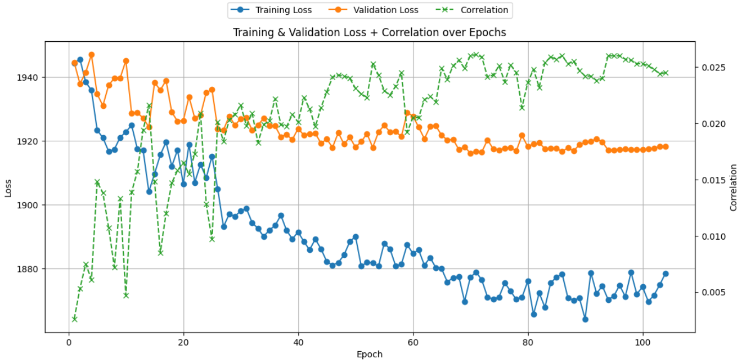
Session 2
Epoch 1
Train loss: 1944
Validation loss: 1944
correlation: 0.0026
Epoch 104
Train loss: 1878
Validation loss: 1918
correlation: 0.0245

Slide 44
Session 3
In this session we increase the learning rate and the limit data parameter.
We also change the optimizer: now it's more conservative in automatically adjusting the learning rates (because the variance estimate changes more slowly).
!python train.py --dataset data/allen --output_dir runs/v1t_model --core vit --readout gaussian2d --behavior_mode 0 --shift_mode 0 --epochs 300 --batch_size 8 --limit_data 3000 --lr 0.008 --adam_beta2 0.98 --criterion correlation

Slide 45
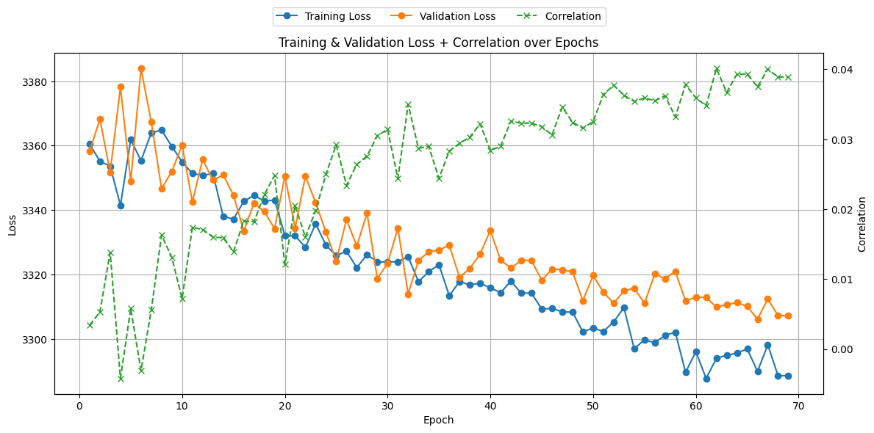
Session 3
Epoch 1
Train loss: 3361
Validation loss: 3367
correlation: 0.0068
Epoch 69
Train loss: 3288
Validation loss: 3307
correlation: 0.0402

Slide 46
Session 4
In this session we lower the learning rate and try image resizing (to 36x64).
We also changed the verbose parameter to give us more informations about training.
!python train.py --dataset data/allen --output_dir runs/v1t_finetune --core vit --readout gaussian2d --behavior_mode 0 --shift_mode 0 --resize_image 1 --batch_size 16 --lr 0.0005 --core_lr 0.0005 --epochs 300 --adam_beta1 0.9 --adam_beta2 0.98 --adam_eps 1e-6 --save_plots --verbose 3

Slide 47
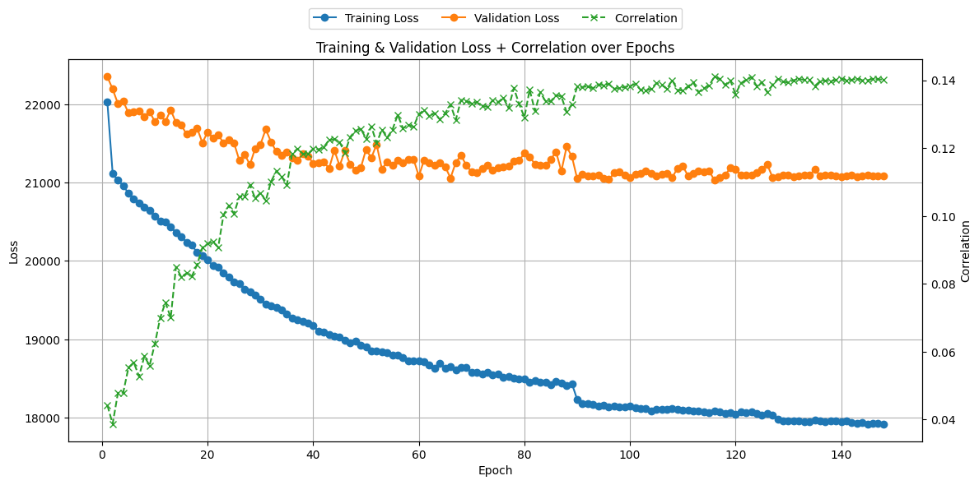
Session 4
Epoch 1
Train loss: 22028
Validation loss: 22353
correlation: 0.0442
Epoch 148
Train loss: 17924
Validation loss: 21102
correlation: 0.1402

Slide 48
Session 5
In this session we use two separate learning rates (readout and core). This is done by removing limit data.
We also switch to Colab Pro and use all the samples available since we now have the computational power to do it.
!python train.py --dataset data/allen --output_dir runs/v1t_model --core vit --readout gaussian2d --behavior_mode 0 --shift_mode 0 --batch_size 16 --verbose 3 --lr 0.004 --core_lr 0.007 --epochs 300 --save_plots

Slide 49
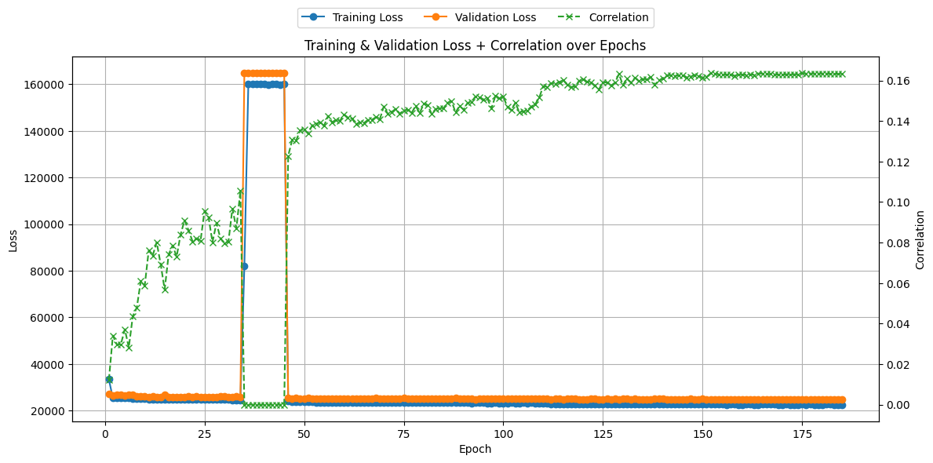
Session 5
Epoch 1
Train loss: 33400
Validation loss: 27170
correlation: 0.0121
Epoch 185
Train loss: 22594
Validation loss: 24921
correlation: 0.1633

Slide 50
Session 6
We change the original V1T code and we're now able to use behaviors during training, particularly running speed.
However this doesn't have much impact on performance because pupil data is not available.
!python train.py --dataset data/allen --output_dir runs/v1t_model --core vit --readout gaussian2d --behavior_mode 1 --shift_mode 0 --batch_size 16 --verbose 3 --lr 0.004 --core_lr 0.007 --epochs 300 --save_plots

Slide 51
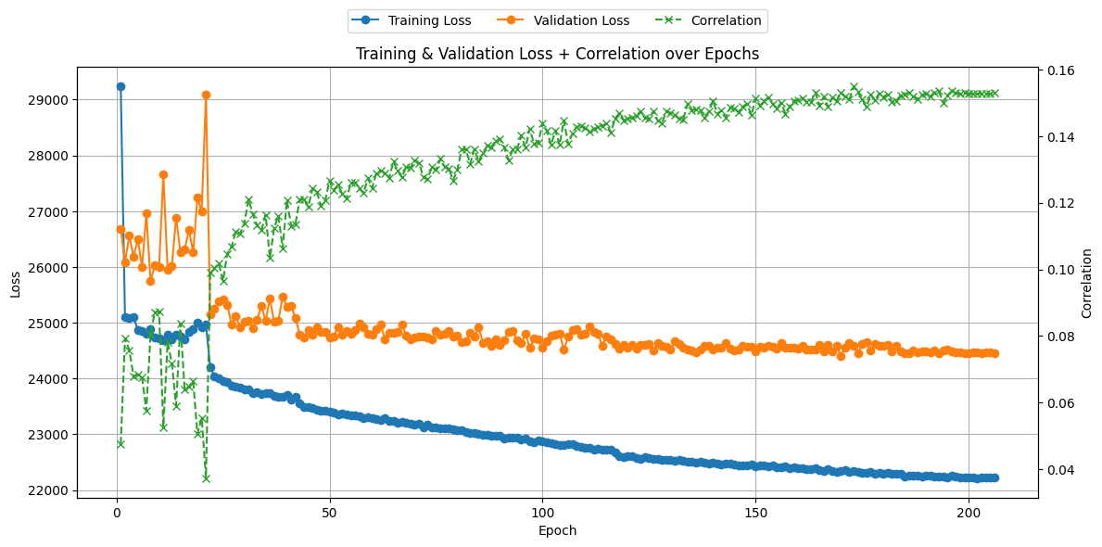
Session 6
Epoch 1
Train loss: 29232
Validation loss: 26684
correlation: 0.0476
Epoch 206
Train loss: 22218
Validation loss: 24460
correlation 0.1529

Slide 52
CONCLUSIONS
And Closing Statements

Slide 53
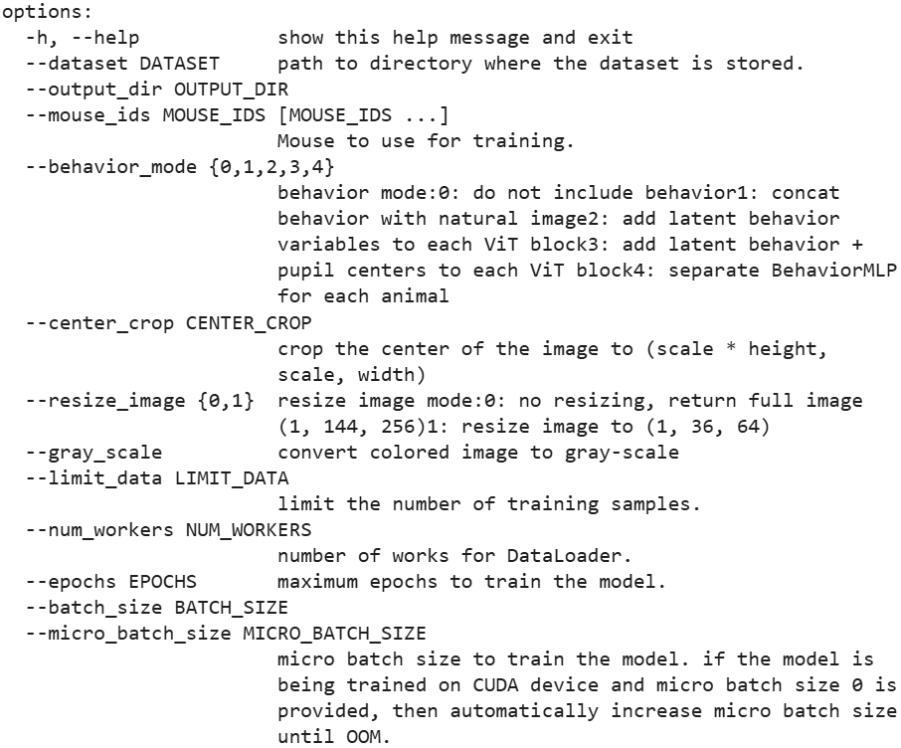
Best Parameters
We tried different values for core learning rate and readout learning rate, increasing the batch size to 16, and set the readout gaussian 2d improved the correlation.
In particular, the best readout suggested by the Bryan Li is Gaussian 2D. This takes into account the neuron coordinates from cell_motor_coordinates.npy.
This readout accounts for spatial arrangement of neurons to model their responses
As for the best starting lr for the core part it is 0.004, for the readout part it is 0.007.
Training Parameters (Epochs & Batch Size)

Slide 54
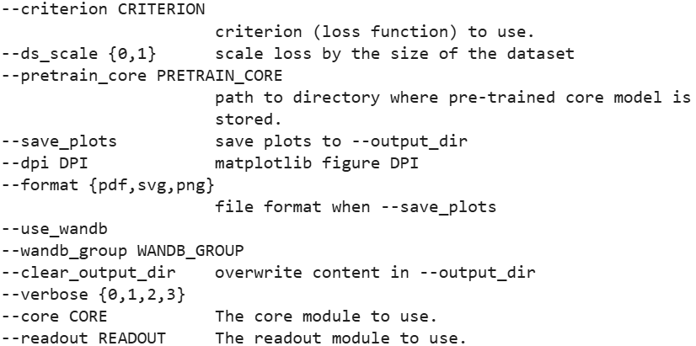
Conclusions
In addition to the sessions shown, other training sessions were carried out as well. We tried different lr, lr_core, batch size and loss.
The correlation value remains static because of unavailable behaviors.
As brain response is heavily influenced by its current state.
The session with best results is the 5th, reaching a correlation value 0.16
Training Parameters (Loss & Readout)

Slide 55




THANK YOU
Fernando Riccioli, Nunzio Fornitto, Angelo Frasca

